Slide 1
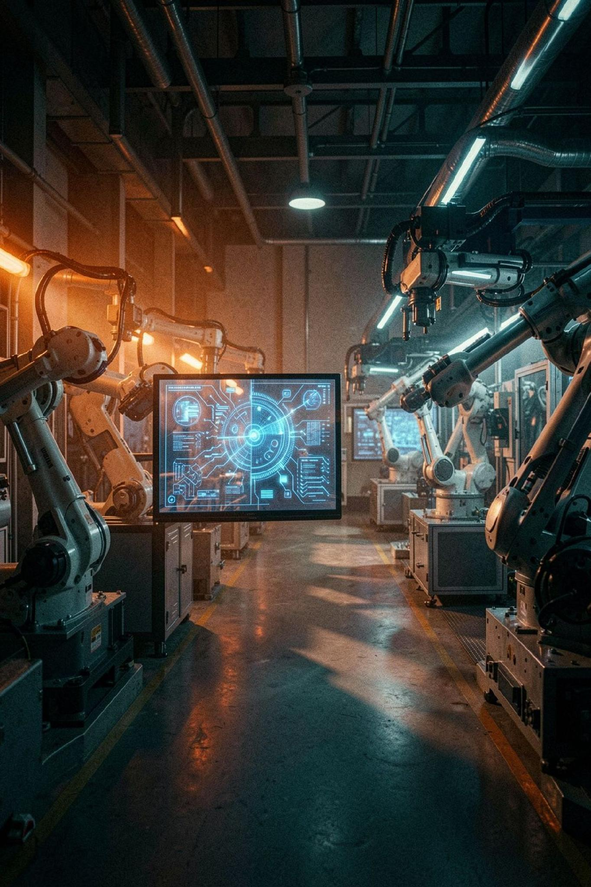

Infosys
Machine Learning System for
Early Detection of Equipment
AI-Powered Industrial Predictive Maintenance
Infosys Springboard 7.0 Internship
Milestone 4 Submission
Domain: Artificial Intelligence

Slide 2



The Problem: Reactive Maintenance Costs
UNPLANNED BREAKDOWNS
Unexpected machine failures interrupt production and cause major financial losses.
REACTIVE MAINTENANCE
Traditional maintenance responds after a breakdown, increasing repair cost and downtime.
DATA COMPLEXITY
Industrial sensors generate large volumes of temperature, torque, speed, and vibration data that are difficult to monitor manually.
THE NEED
Predict failures before they occur and enable proactive maintenance planning.

Slide 3


SYSTEM ARCHITECTURE & TECHNOLOGY STACK
PRESENTATION LAYER
Prediction Results
User
React, Vite, and TypeScript provide a fast and responsive dashboard. Tailwind CSS is used for the UI, and Recharts displays real-time sensor data.
Returned to UI with insights
Initiates request via dashboard
APPLICATION LAYER
LightGBM + SHAP
Prediction Pipeline
React Frontend
Model inference and explainability
Vite + TypeScript UI
FastAPI processes prediction requests asynchronously. JWT authentication secures user access, and Motor enables efficient MongoDB communication.
MongoDB
FastAPI Backend
DATA & ML LAYER
Stores features & metadata
Handles API and validation
MongoDB stores machine and prediction data. LightGBM predicts machine failures, SHAP explains each prediction, and Docker supports deployment.
Flow of user requests through the system stack to prediction output and explainability.

Slide 4
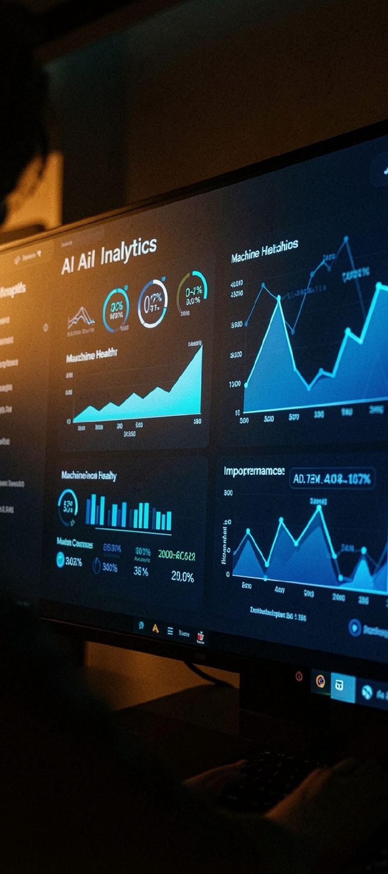



MACHINE LEARNING ENGINE
MULTI-MODEL MACHINE LEARNING ENGINE
The system evaluates and compares 13 machine learning algorithms, including LightGBM, XGBoost, CatBoost, Random Forest, Extra Trees, Gradient Boosting, Decision Tree, MLP, KNN, AdaBoost, SVM, Logistic Regression, and Naive Bayes. The training pipeline automatically preprocesses the AI4I 2020 Predictive Maintenance Dataset by performing scaling, one-hot encoding, and outlier handling before model evaluation.
DUAL-STAGE FAILURE PREDICTION
Stage 1 predicts whether a machine failure is likely to occur. Stage 2 classifies the specific failure mode as Tool Wear Failure (TWF), Heat Dissipation Failure (HDF), Power Failure (PWF), Overstrain Failure (OSF), or Random Failure (RNF).
EXPLAINABLE AI (SHAP)
SHAP values provide feature-level explanations for every prediction, showing which sensor variables increased or decreased the failure probability and helping engineers make transparent maintenance decisions.

Slide 5
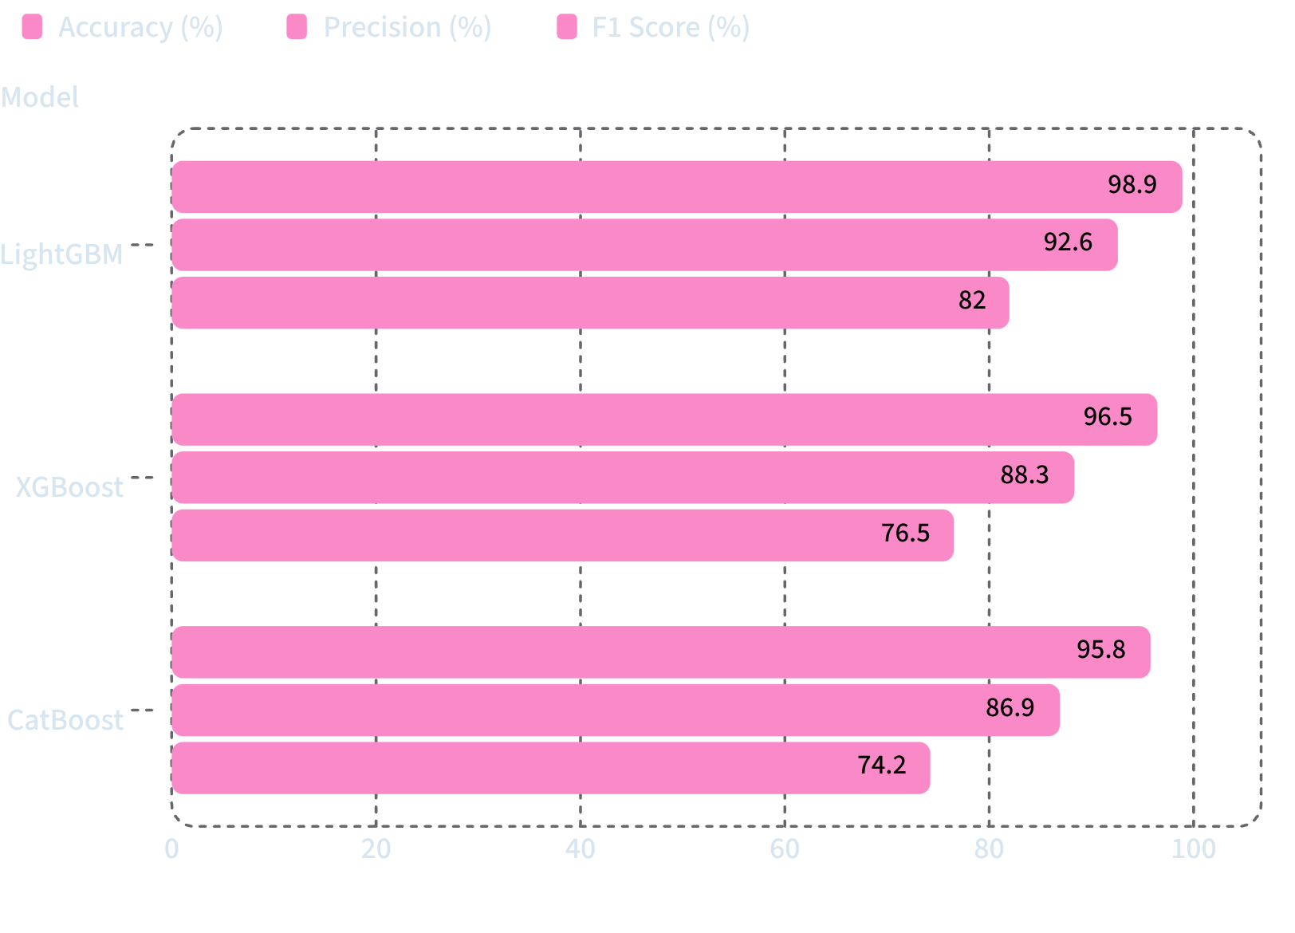
Model Performance: LightGBM Excellence
MODEL PERFORMANCE ANALYSIS
We compared 13 models using Stratified K-Fold Cross Validation on the AI4I 2020 Predictive Maintenance Dataset. LightGBM delivered the strongest overall results, with the highest accuracy at 98.90% and consistently strong precision and F1 performance.
13 machine learning algorithms were evaluated.
LightGBM delivered the highest overall prediction accuracy (98.90%).
The selected model is used for real-time failure prediction and SHAP-based explainability.

Slide 6
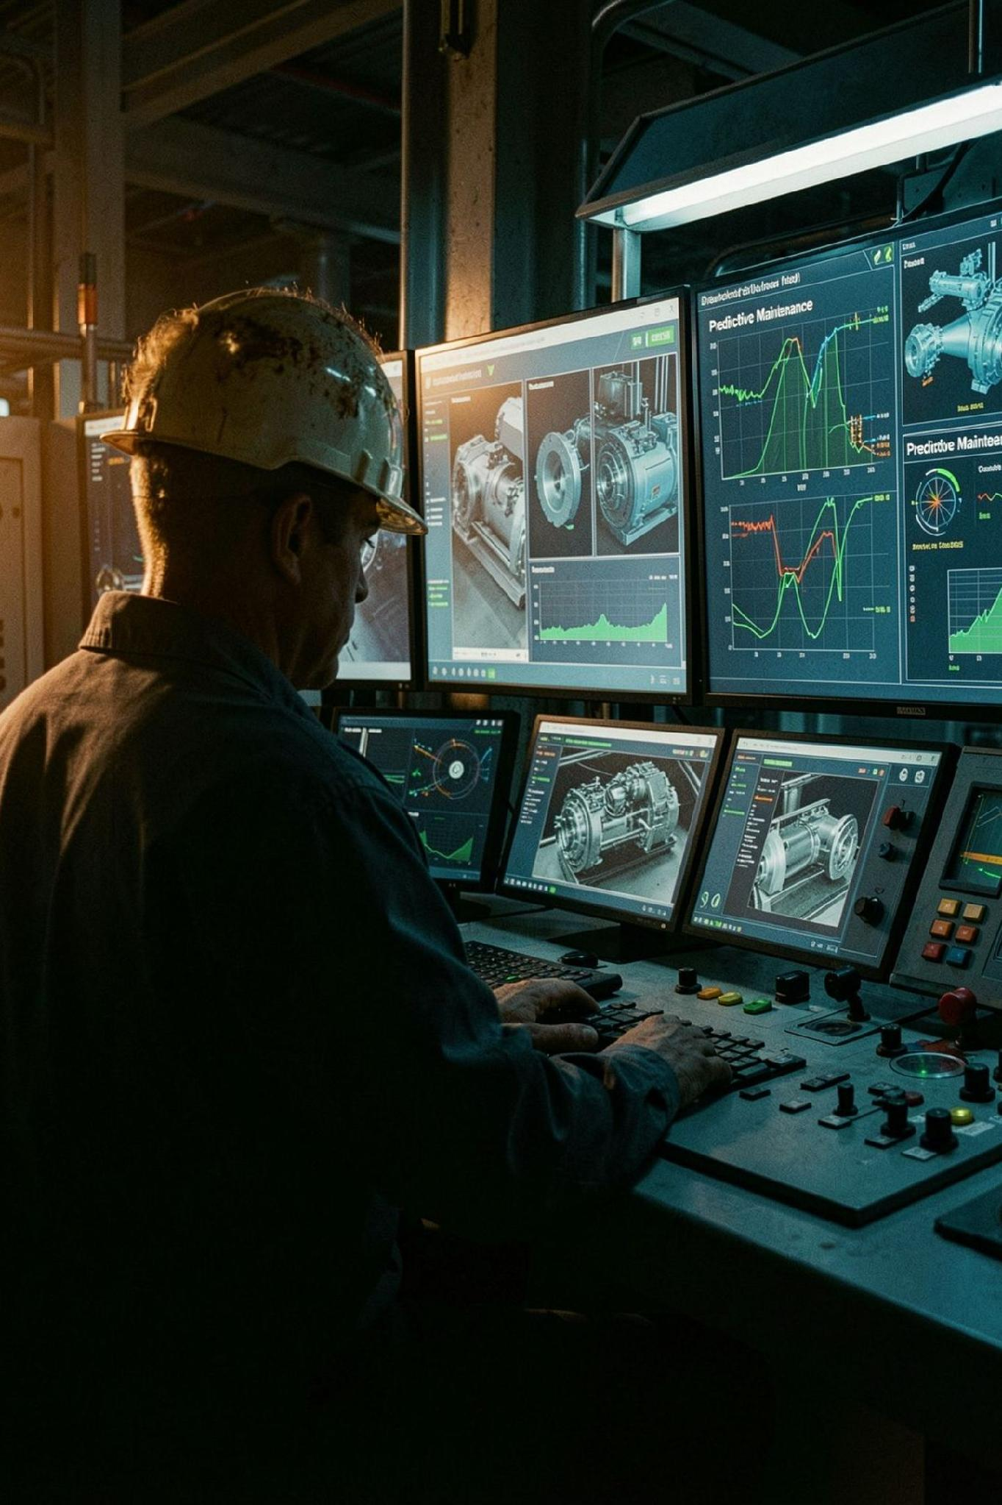


IMPACT & FUTURE VISION
KEY BENEFITS
FUTURE ROADMAP
Reduced machine downtime through early failure prediction.
Integrate IoT sensor feeds for real-time industrial data collection.
Failure mode identification (TWF, HDF, PWF, OSF, RNF) enables targeted maintenance actions.
Expand deployment using Docker and cloud infrastructure for scalable monitoring.
SHAP-based explainable AI and real-time monitoring improve maintenance decisions and operational reliability.
Implement Remaining Useful Life (RUL) prediction for predictive maintenance scheduling.
The system combines machine learning, explainable AI, and a scalable full-stack architecture to improve industrial reliability and support proactive maintenance.

